Slide 1

Analysis of PM2.5 data in Shanghai
Identify the factors affecting the change of PM2.5 in Shanghai
Stat350 Fall 2019
Group member:
Lao Chin Wang
Xiaoliang Zhang
Ao Tang

Slide 2
Introduction
Description
The dataset shows the hourly data of PM2.5 in Shanghai from 1st of January 2010 to 31st December 2015.
PM2.5 refers to the atmospheric particulate matter that have a diameter of less than 2.5 micrometers. In the other words, it reports the air quality of the certain areas.
Format
31880 observation on 13 variables are given in the dataset.
Source
This dataset was taken from the UCL Machine Learning Repository which is maintained by Guanghua School of Management at Peking University.

Slide 3
Full model
Variable Selection
Diagnostics
Test MSE & CV
Diagnostics
Transformation
Best model
Ridge & Lasso
Diagnostics

Slide 4
Variable description
Response Variable :
PM 2.5: PM2.5 concentration (ug/m^3)
Regressors:
No: row number
year: year of data in this row
month: month of data in this row
day: day of data in this row
hour: hour of data in this row
season: season of data in this row
DEWP: Dew Point (Celsius Degree)
TEMP: Temperature (Celsius Degree)
HUMI: Humidity (%)
PRES: Pressure (hPa)
cbwd: Combined wind direction
Iws: Cumulated wind speed (m/s)
precipitation: hourly precipitation (mm)
Iprec: Cumulated precipitation (mm)

Slide 5
Variable description
Response Variable :
PM 2.5: PM2.5 concentration (ug/m^3)
Regressors:
month: month of data in this row
day: day of data in this row
hour: hour of data in this row
season: season of data in this row
DEWP: Dew Point (Celsius Degree)
TEMP: Temperature (Celsius Degree)
HUMI: Humidity (%)
PRES: Pressure (hPa)
cbwd: Combined wind direction
Iws: Cumulated wind speed (m/s)
Iprec: Cumulated precipitation (mm)

Slide 6
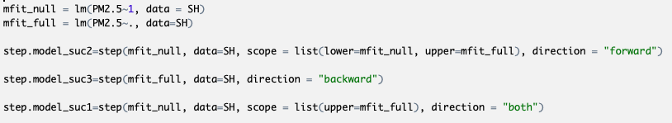
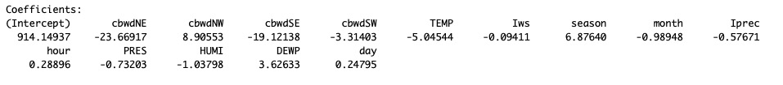
Variable Selection
Stepwise
The best model is :
lm( formula = PM2.5 ~ cbwd + TEMP + Iws + season + month + Iprec + hour +
PRES + HUMI + DEWP + day, data = SH )

Slide 7
Model selection before transformation
Information Criteria | Selection Direction | Final Selected Model ( Before transformation) | AIC Value
AIC | Forward | PM2.5 ~ cbwd + TEMP + Iws + season + month + Iprec + hour + PRES + HUMI + DEWP + day | 48059.01
AIC | Backward | PM2.5 ~ cbwd + TEMP + Iws + season + month + Iprec + hour + PRES + HUMI + DEWP + day | 48059.01
AIC | Stepwise | PM2.5 ~ cbwd + TEMP + Iws + season + month + Iprec + hour + PRES + HUMI + DEWP + day | 48059.01

Slide 8
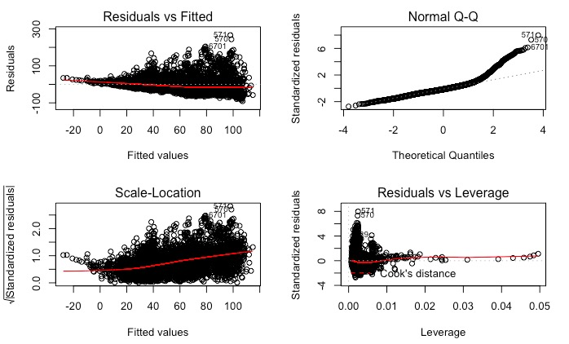
Assumptions (Final Model before transformation)

Slide 9
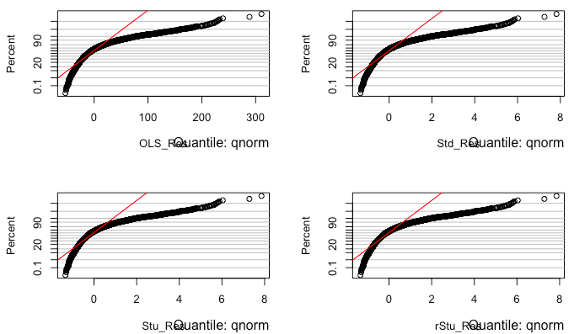
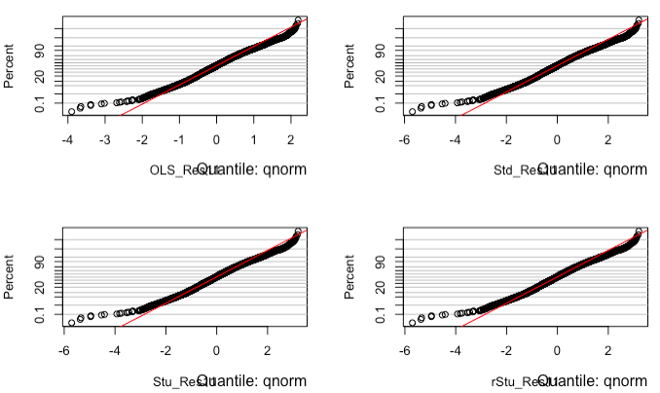
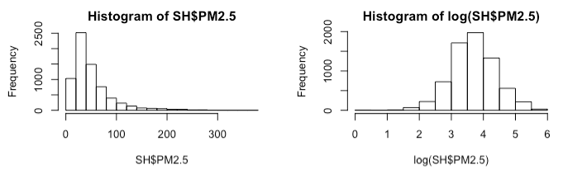
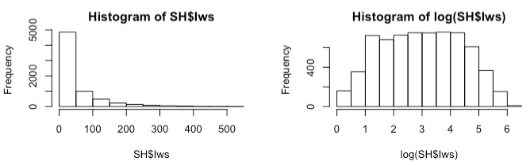
Variable Transformation（log Transformation ）

Slide 10
Transformation
Before :
PM2.5 ~ cbwd + TEMP + Iws + season + month + Iprec + hour + PRES +
HUMI + DEWP + day
After :
log(PM2.5)~ cbwd + TEMP + log(Iws+1) + season + log(month) +
log(Iprec+1) + hour + PRES + HUMI + log(DEWP+17) + day

Slide 11
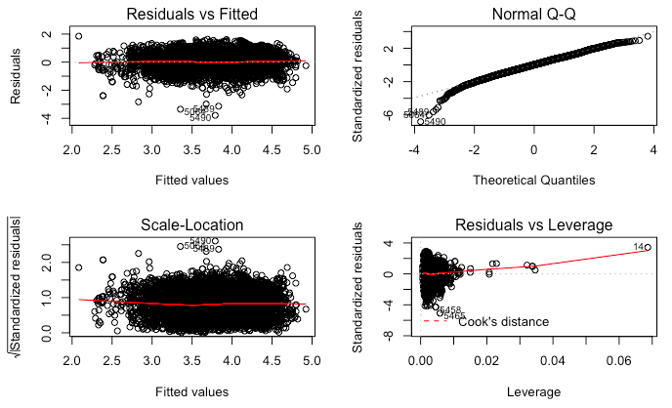
Final Model Analysis
Transformation | Estimated σ | R^2 | Adj. R^2 | F-statistic | P-value
Before | 33.36 | 0.3075 | 0.3060 | 216.7 | 2.2e-16
After | 0.5576 | 0.3665 | 0.3652 | 282.4 | 2.2e-16

Slide 12
Model selection after transformation
Information Criteria | Selection Direction | Final Selected Model ( Before transformation) | AIC Value
AIC | Forward | log(PM2.5)~ cbwd +TEMP +log(1+Iws) +season +log(month) +log(1+Iprec) +hour+PRES +HUMI+ log(DEWP+17) +day | -7985.76
AIC | Backward | log(PM2.5)~ cbwd +TEMP +log(1+Iws) +season +log(month) +log(1+Iprec) +hour+PRES +HUMI+ log(DEWP+17) +day | -7985.76
AIC | Stepwise | log(PM2.5)~ cbwd +TEMP +log(1+Iws) +season +log(month) +log(1+Iprec) +hour+PRES +HUMI+ log(DEWP+17) +day | -7985.76

Slide 13
Ridge and Lasso

Slide 14
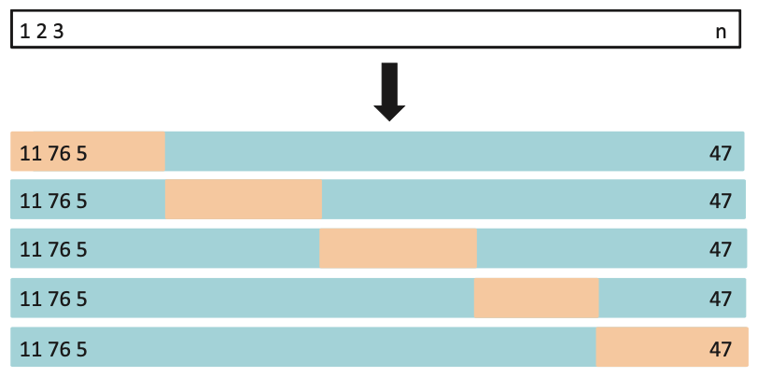
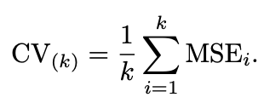
5-fold Cross Validation (CV)
Goal：
Determine how well a given model can be expected to perform on independent data.

Slide 15
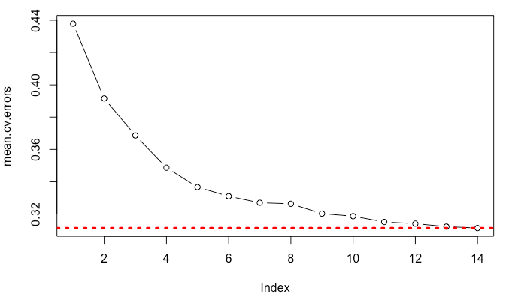
Mean.cv.errors vs Degree of Polynomial
The smallest mean of C.V. error can be obtained when the index equals to 14

Slide 16
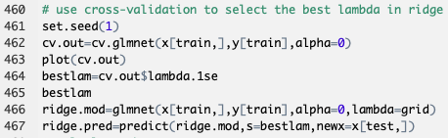



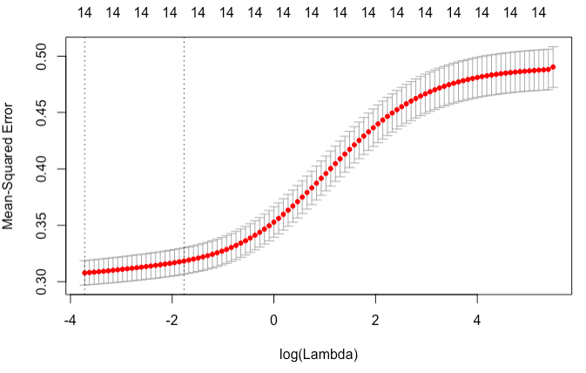
Ridge Regression
1. We plot the mean squared error with log (λ ) to find selected number of variables which is 14 variables.
2. Then, the second vertical dash line shows the best λ in the model, which is 0.170832.
3. After that, we calculate the mean squared error is 0.3256117.

Slide 17
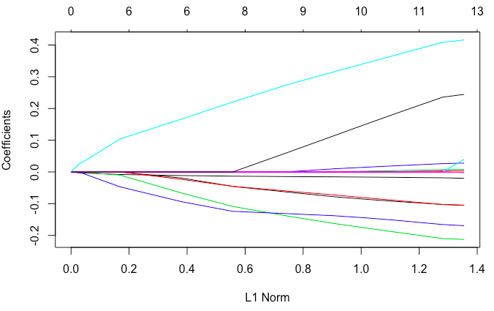
Lasso Regression
Moving left to right, if λ is zero, it simply give us all coefficient is zero, so depending on the value of λ, the lasso can produce a model involving any number of variables.

Slide 18


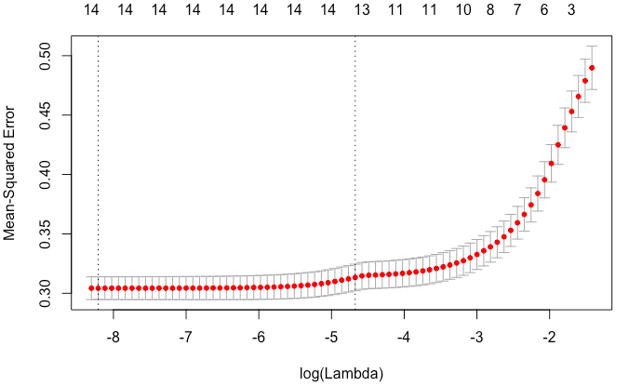



Slide 19
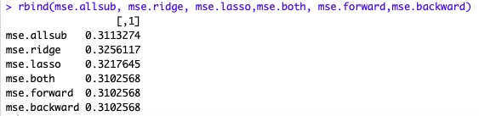
Conclusion
By comparing three MSE
From the above result, we can notice that stepwise is the smallest among MSE.
Therefore, stepwise model is the best model.

Slide 20
Questions?
Thankyou!!

